Slide 1

Women’s mid-life health experiences in urban UK, a factor analysis
Veronica Tuffrey, Trina Ward & Volker Scheid
School of Life Sciences, University of Westminster
Notes:
This is my presentation

Slide 2
Background – Menopause
Individual experiences of menopause vary greatly
Many symptoms attributed to process of menopause, but difficult to differentiate age-related symptoms from those due to menopause
The experience also differs across ethnic groups / nationally, indicating that symptoms are influenced by culture
Complex combination of biological, psychological and cultural factors, so research into a “menopausal syndrome” is undertaken using varied epistemological positions and research frameworks.

Slide 3
Background – menopause in the UK
Has been claimed that up to 80% of women experience menopausal symptoms, and 45% of these find the symptoms distressing
Not clear what exactly these symptoms are; how they differ between ethnic groups; how they relate to aging v. menopause, or how they compare to other regions
Methodological problems as to how existing data were compiled – bias in questions; most data from Caucasians, and varied methods used.

Slide 4
Background – this survey
An attempt to overcome these difficulties
Understand contemporary women’s experience
Compare variations across ethnic groups in urban UK
Allow cross-cultural comparisons of symptom prevalence with studies from the US, Canada, Japan and China
One stage of larger research project exploring potential for integration of East Asian medical treatment strategies for symptoms associated with the menopause into the NHS

Slide 5
Methods – sampling
GP lists in Lambeth, Lewisham and Southwark due to ethnic diversity
Targeted electoral wards using Index of Multiple Deprivation
Women between 45 – 55 years old
Mailed 1931 booklets; response rate of 58%

Slide 6
Methods – questionnaire
Self-administered; postal; didn’t use “menopause” in the title or in questions; two week recall; “Yes” / “No” response
Adapted general symptom checklist with “menopause-related” symptoms embedded – 37 symptoms of which 15 “core” symptoms from the four older studies
Pre-menopausal = menstruating regularly
Peri-menopausal = menses irregular over previous year, or menstruated in the past 12 months but not the last 3
Post-menopausal = no menstruation in last 12 months
Non-natural menopause = stopped menstruating following surgery, radiotherapy or chemotherapy

Slide 7
Methods – data analysis
Basic statistical analysis undertaken using SPSS V.15.0
For those subjects who had missing responses for only one or two of the 37 symptoms, imputed negative response for these questions
Exploratory factor analysis using STATA Release 9
FA applied to menopausal symptom data to detect symptom clusters, and findings used to argue against menopausal syndrome
FA ideally applied to normally-distributed continuous variables, so inappropriate for binary variables?
Where binary variables are indicators of underlying continuous variables, can use FA with tetrachoric correlation matrices
So obtained tetrachoric correlation matrix, then applied factormat using the principal component method (+ varimax rotation with Kaiser normalization)

Slide 8
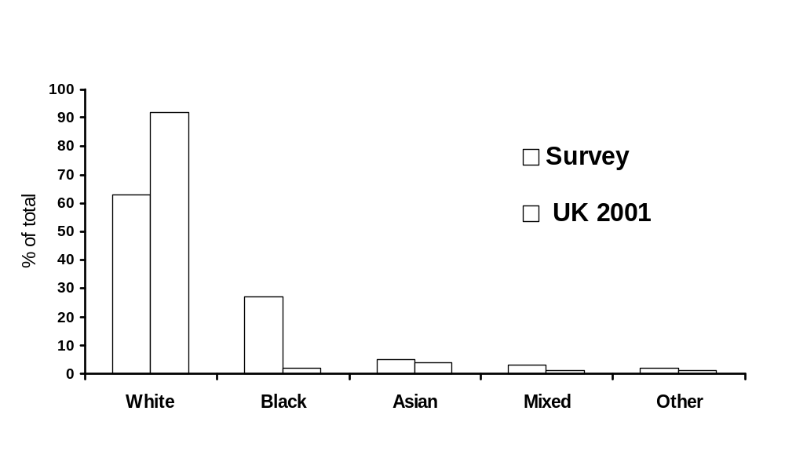
Findings - sample
Stage: 29% pre-menopausal; 42% peri-menopausal;
29% post-menopausal (total N = 883)
Ethnic group:

Slide 9
Findings – Most frequently reported symptoms
Question Symptom N Prev.
31 Tiredness 880 64.0%
10 Aches or stiffness in the joints 862 52.1%
22 Hot flush and/or sudden sweating 875 47.2%
18 Feeling low or depressed 874 44.4%
9 Headache 862 42.1%
15 Irritability 870 41.5%
14 Insomnia 880 38.9%
8 Backache affecting the lower back 860 38.8%
37 Puffiness anywhere on body 875 35.4%
20 Dry skin or eyes 877 34.5%

Slide 10
Findings – Least frequently reported symptoms
Question Symptom N Prev
24 Hot flush most frequently in daytime 869 20.9%
17 Dizzy spells 874 20.5%
5 Short of breath 862 18.7%
21 Sore throat 872 16.3%
28 Sweating on head only 870 14.7%
11 Pain/discomfort in chest 862 14.7%
3 Nausea 863 12.6%
4 Persistent cough 860 12.4%
29 Sweating on chest & extremities only 868 8.8%
33 Increased libido 870 6.2%

Slide 11
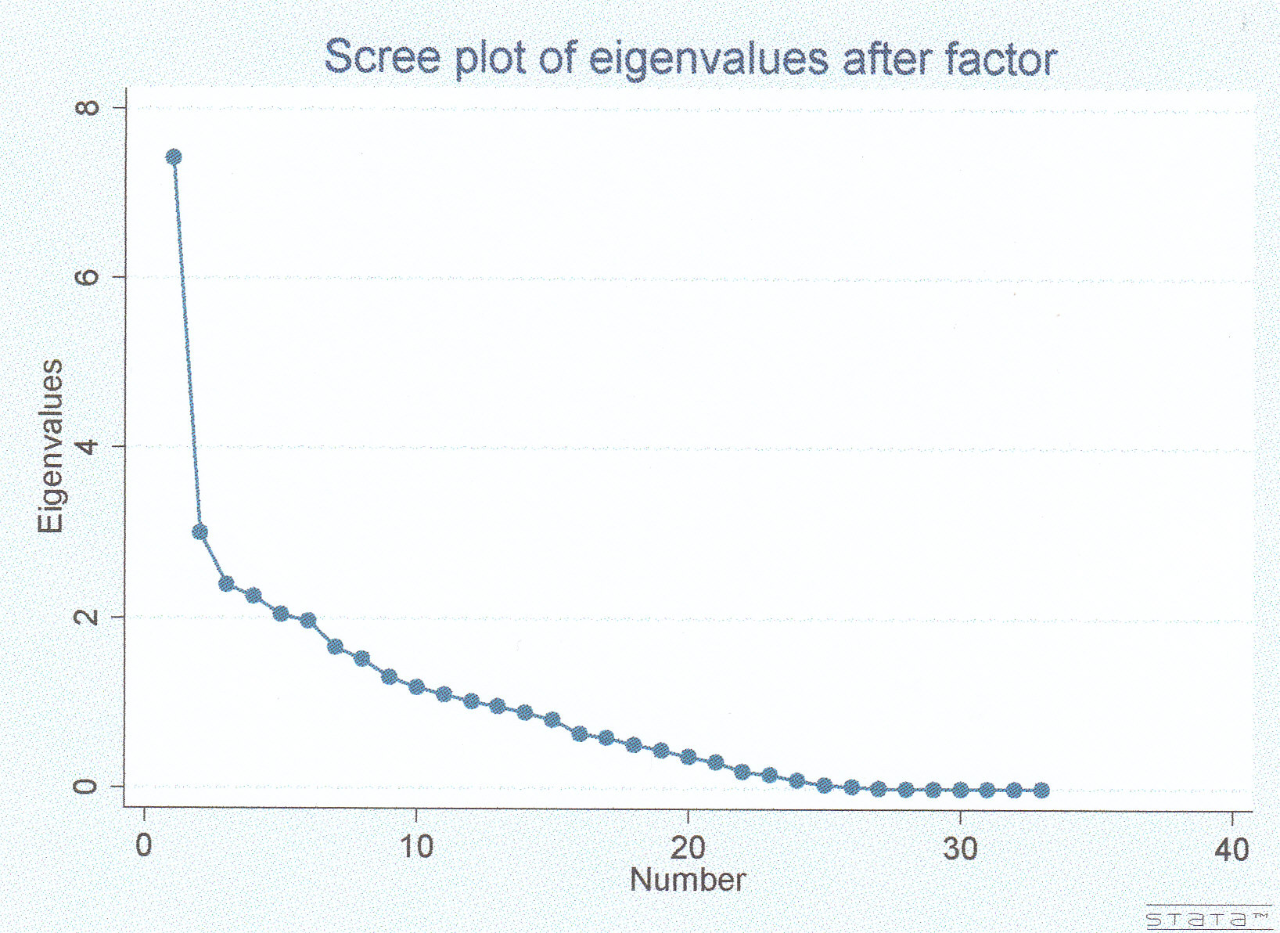

Slide 12
F1 F2 F3 F4 F5
Factor 1 “Vasomotor 1”
Q23 Hot flushes with sweating 0.91
Q22 Hot flushes and/or sudden sweating 0.89
Q19 Feel hot most of the time 0.78
Q30 Sweat all over 0.76
Q27 Sweating easily (spontaneously) 0.70
Q24 Hot flush most frequently in daytime 0.69
Q25 Hot flush most frequently in night time 0.68 0.39
Q28 Sweating on head only 0.31 0.30
Factor 2 “Physical / Psychological 1”
Q10 Aches or stiffness in the joints 0.63
Q15 Irritability 0.61
Q31 Tiredness 0.61 0.33
Q18 Feeling low or depressed 0.55
Q8 Backache affecting the lower back 0.54
Q35 Dislike of being near draught 0.54 0.48
Q14 Insomnia 0.52
Q37 Puffiness anywhere on body 0.50
Q34 Decreased libido 0.50
Q7 Backache affecting neck or shoulders 0.47 0.36
Q20 Dry skin or eyes 0.47
Q9 Headache 0.35 0.31

Slide 13
F1 F2 F3 F4 F5
Factor 3 “Physical / Psychological 2”
Q5 Short of breath 0.74
Q4 Persistent cough 0.74
Q11 Pain/discomfort in chest 0.70
Q17 Dizzy spells 0.34 0.56
Q3 Nausea 0.51 0.42
Q21 Sore throat 0.50
Q16 Awareness of heartbeat (palpitations) 0.43
Q33 Increased libido 0.42
Factor 4 “Physical (Gut)”
Q1 Diarrhoea or constipation 0.81
Q2 Upset stomach 0.86
Q12 Pain or discomfort in stomach 0.83
Q13 Pain or discomfort in low abdomen 0.68
Factor 5 “Vasomotor 2”
Q26 Cold sweats and/or night sweats 0.48 0.61
Q36 Tending to get cold feet 0.44 0.57
Q29 Sweating on chest & extremities only 0.76

Slide 14
Findings – other
No statistically significant variation by ethnicity in hot flushes – unlike data from the USA (black women experienced more)
Insomnia, irritability, and tiredness varied according to ethnicity with the Black ethnic group at lower risk

Slide 15
Discussion and Conclusion
London women experience high levels of symptoms
Patterns of symptoms from this multi-ethnic group do not permit simple classification

Slide 16
Acknowledgements
The UK Department of Health funded this work through a Researcher Development Award for Trina Ward

